Slide 1
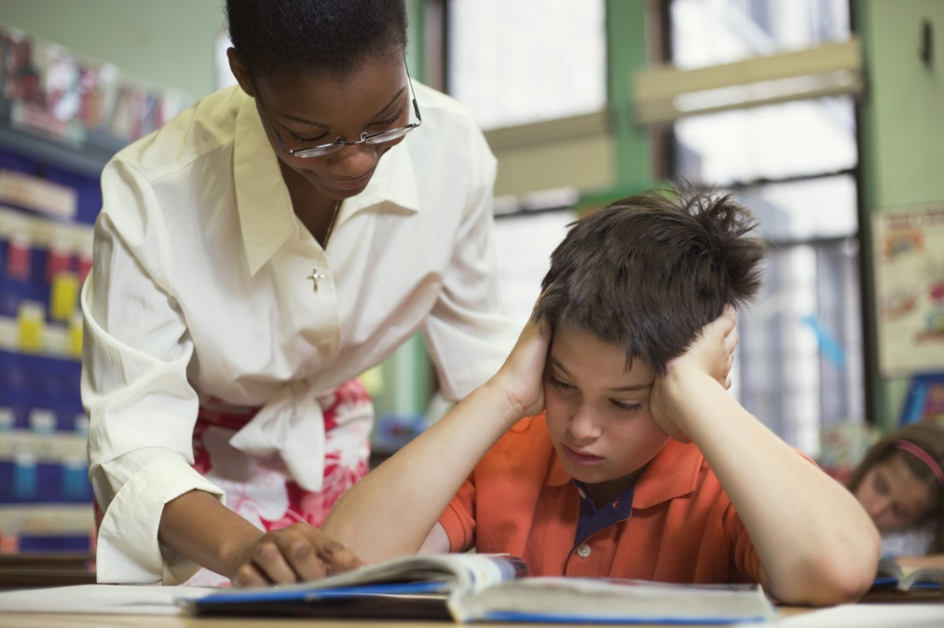
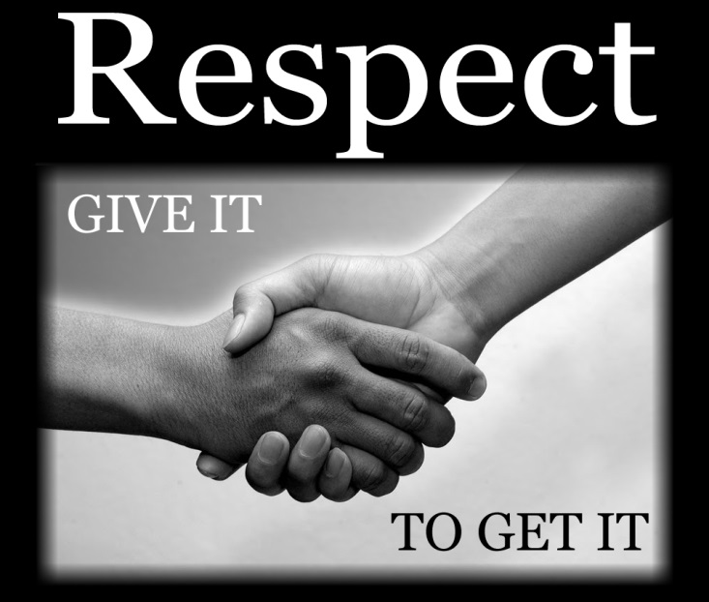
Why should you respect your teachers and colleagues/peers
By Maison Roberts

Slide 2
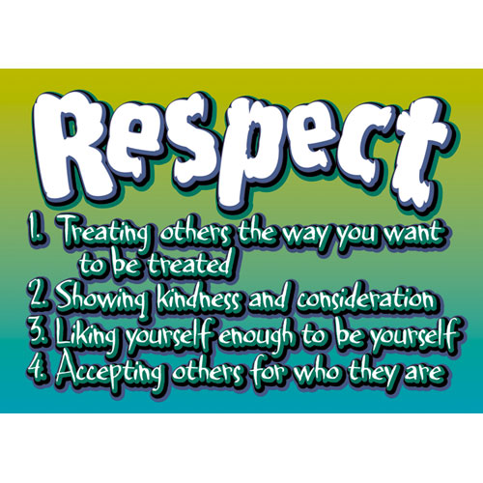
What is respect
Respect is when you be nice to your friends or peers simple things like saying please or thanks you treating others the way you would like to be treated showing kindness and consideration accepting others
for who they are

Slide 3
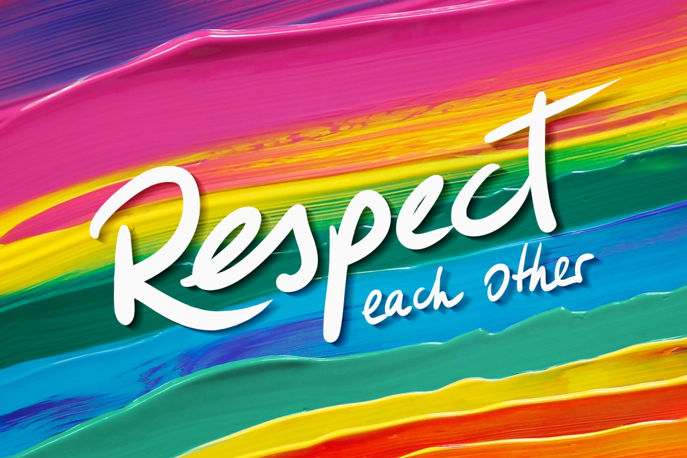
Why show adults respect
You should show adults respect because they help you and are kind there not there just to help you there like you and me there to be treated the same if you don’t like them still treat them the same

Slide 4
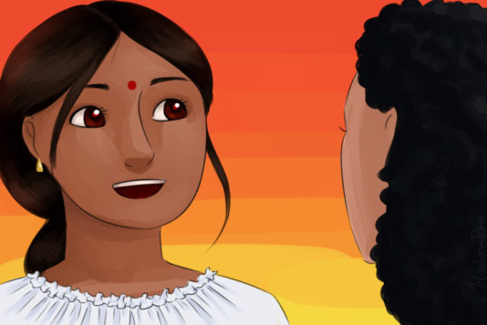
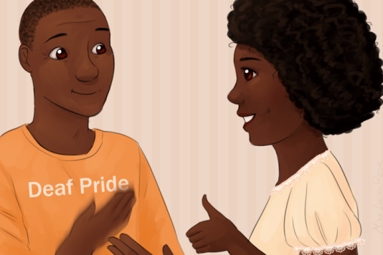
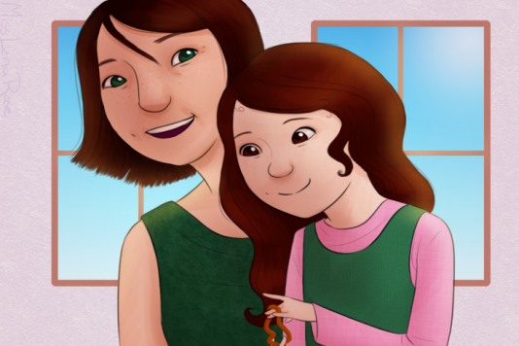
The 3 ways to be respectful
Show kindness and courtesy
Be polite
Don't discriminate.

Slide 5
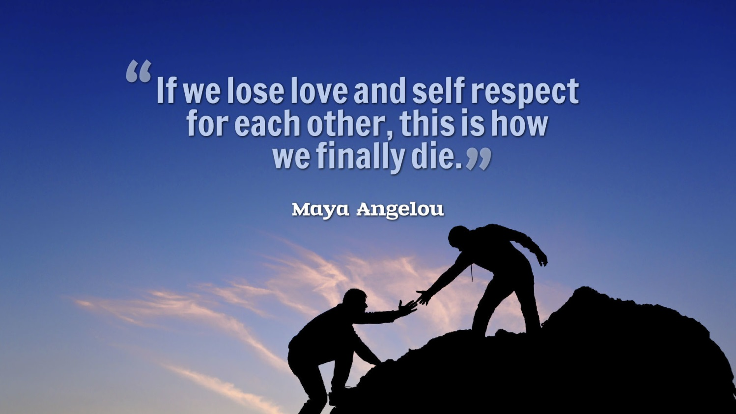
Thanks for reading

